Slide 1
Christmas Micro:bit
Objectives
To understand how run multiple processes simultaneously with your micro:bit. (Screen, sound and LEDs)
Success Criteria
Demonstrate multiple simultaneous processes running on your Micro:bit
Literacy Objective
Be able to enter commands into a computer with accuracy

Slide 2
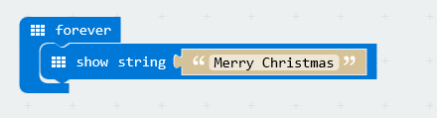
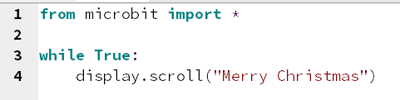
The screen
Starter for 10
Create a Simple message to display on your Micro:bit screen

Slide 3
Making Music
Simple Stuff - Python
You must import the library with Python Import music
There are some pre-made songs try music.play(music.NYAN)
See HERE for a song list
Writing your own
Each note has a name (like c#), an octave (how high or low) and a duration.
Octaves are 0 for the lowest, 4 contains middle C and 8.
Duration is expressed in numbers, the bigger the number the longer the duration. (4 will last twice as long as two for example.
Micropython also supports the note R which means rest
The definition and scope of an octave conforms to the table listed on this page about scientific pitch notation.
NOTE[octave][:duration]
Extra
Tempo and beats - A number of ticks (expressed as an integer) constitute a beat.
Each beat is to be played at a certain frequency per minute (expressed as the more familiar BPM - beats per minute - also as an integer).
music.set_tempo(ticks=4, bpm=120)

Slide 4
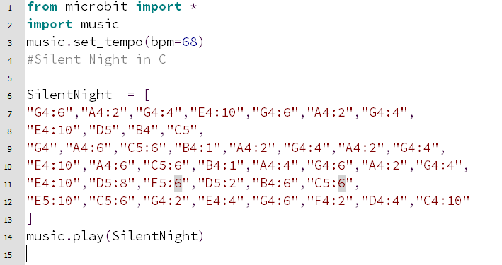
Making Music Python
Python
For this example I have Pin 0 and ground connected to the speaker and we will use this piece of music
G, A, G, E
G, A, G, E
D, D, B..
C, C, G..
A, A, C, B, A, G.. A, G, E..
A, A, C, B, A, G.. A, G, E..
D, D, F, D, B, C, C, E..
C, G, E, G..
F, D, C..
Notation
Working on the basis of a duration of 8 being a full not I’ve come up with the following Python Code.
I’m no musician!! So HERE is the score for you to improve I based it on the score in THIS video.

Slide 5
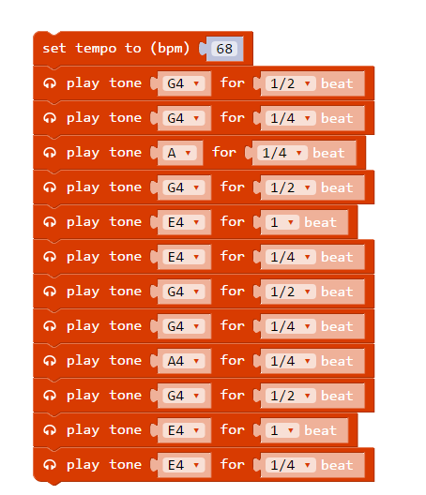
Making Music PXT
PXT
The same notation in PXT would look like below.
Please note the PXT implementation of sound is not as clean as Python – you may need to fiddle with the notes to make it sound right on the speaker

Slide 6
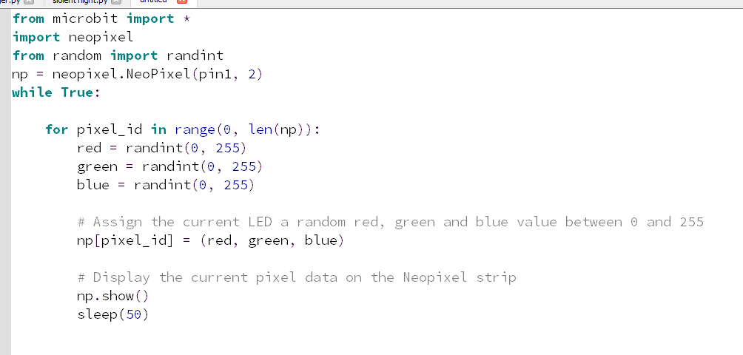
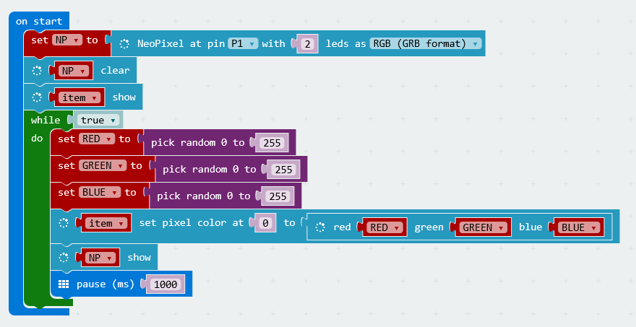
The Lights
For this example I am using a 2 programmable LEDs in parallel. This could easily be a strip of Neo-pixels and would work in the same way.
The only limit is do not use more than 8 LEDs without a separate power supply

Slide 7
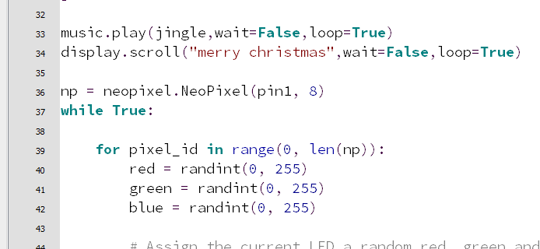
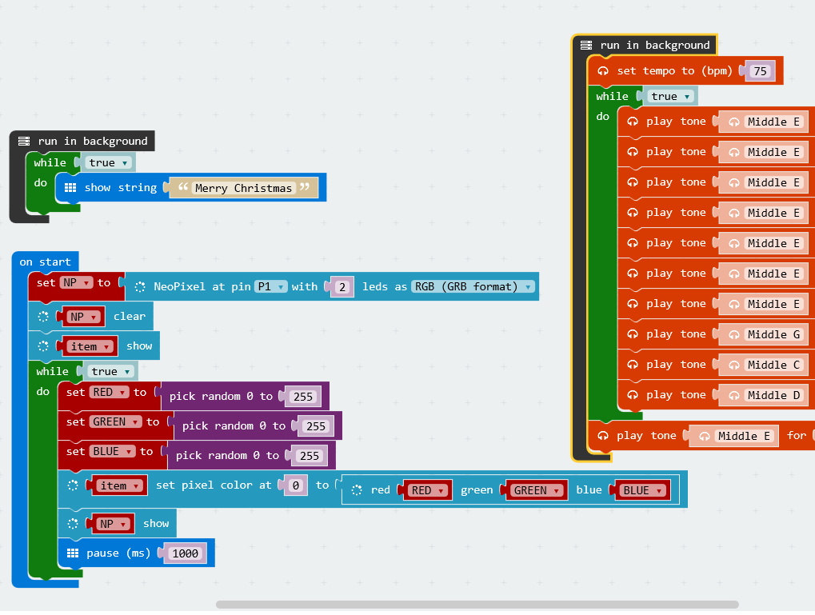
All together now!
MicroPython
MicroPython has a feature that is not well documented that allows you to run processes in the background
wait=False (this can be set to True or False – if False the Micro:bit won’t wait for the process to finish before running the next line of code
Loop = True will force a process to be repeated even if it’s not inside a for or while loop
PXT
The same result can be completed using the “Run in Background” block in PXT

Slide 8
Give it a go
Task
Your turn - Try this
Create a display on your screen that runs as a background processing and loops forever
Write some music to play in the background on a repeat. Try and convert a simple nursery rhyme or carol. I have done Jingle Bells HERE
Using a Neopixel or Programmable LED rotate some pretty colours.
If you only have standard LEDs then you could use red and green and flash them alternatively.
Make all this happen together
Most of all – Be creative and have fun!!

Slide 9
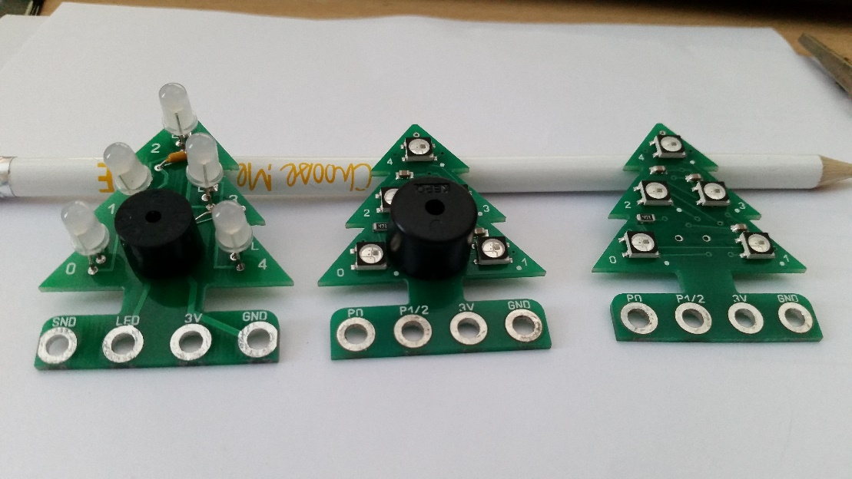
Oh Christmas Tree
PocketmoneyTronics Christmas Tree
www.microbitsandbobs.co.uk have put this resource together in order to support buyers of the awesome http://www.pocketmoneytronics.co.uk/ Christmas Tree.
This is currently on Kickstarter (25/10/16) which I hope is very successful and I’m sure you will be able to buy them direct from Andrew Gale via his website really soon.
At the time of writing, I am aware of 3 Micro:bit versions of the Christmas Tree.
Solder yourself, Neopixel with buzzer and Neopixel without buzzer
All the code here runs with any BBC Micro:bit with a piezo speaker and either standard programmable LED or neopixel ws2812 packages.

